Slide 1
Control Board to Temp Sensors Cable

Slide 2
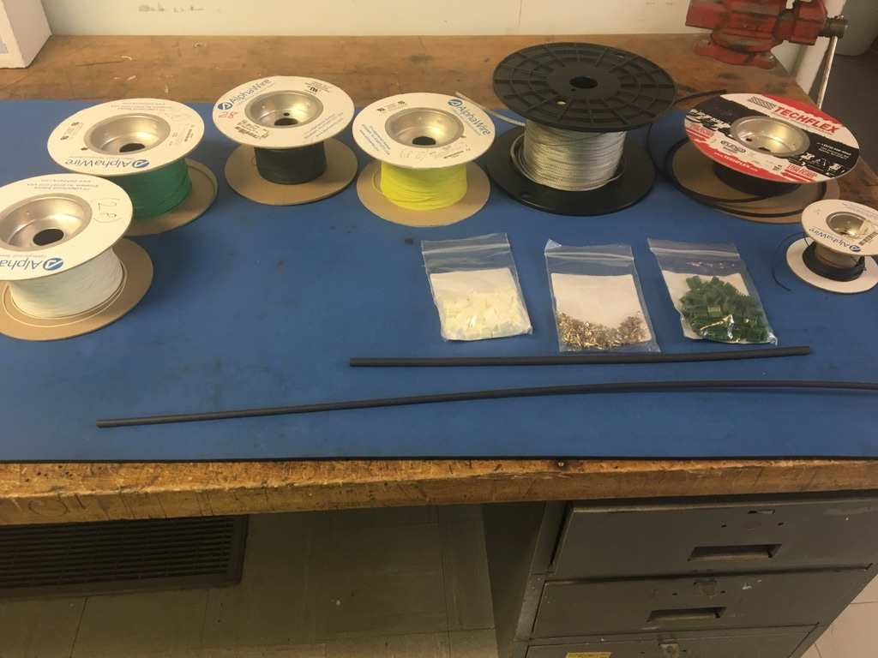
Materials

Slide 3
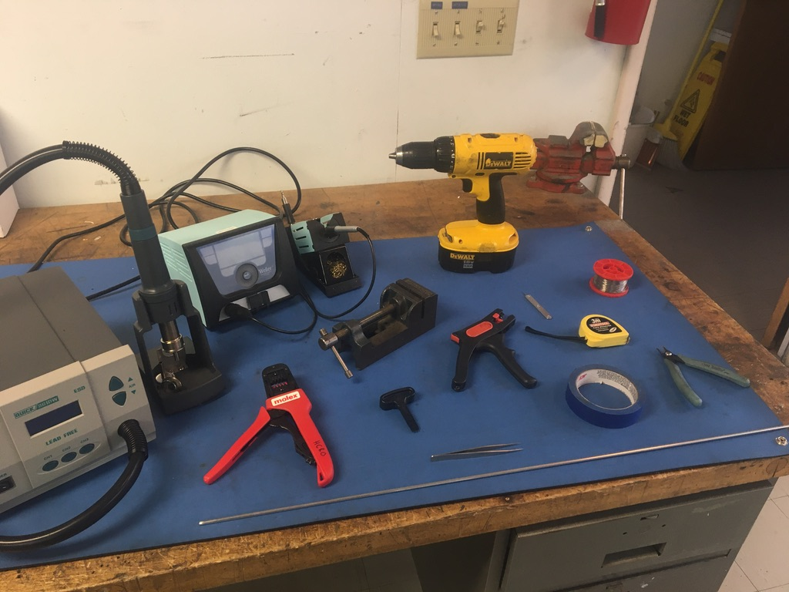
Tools

Slide 4
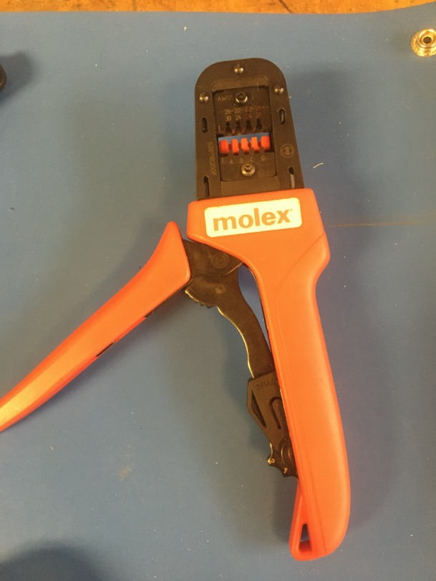
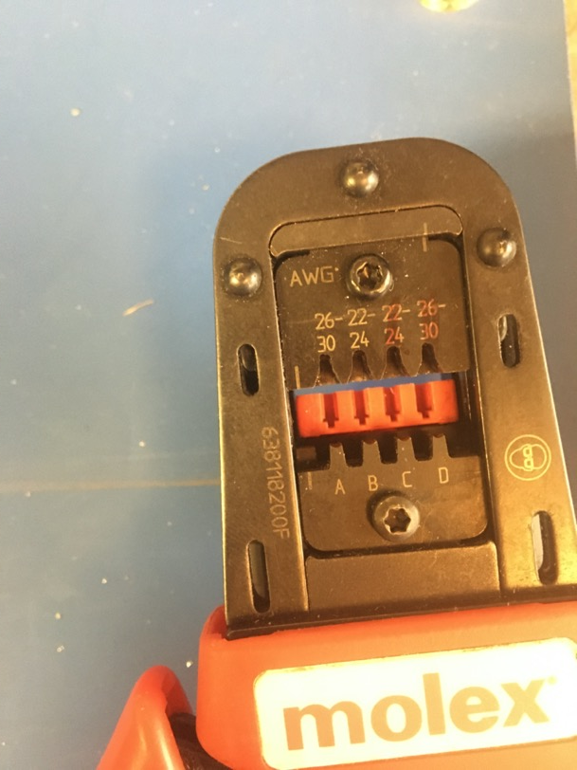
KK 254 Crimping Tool

Slide 5
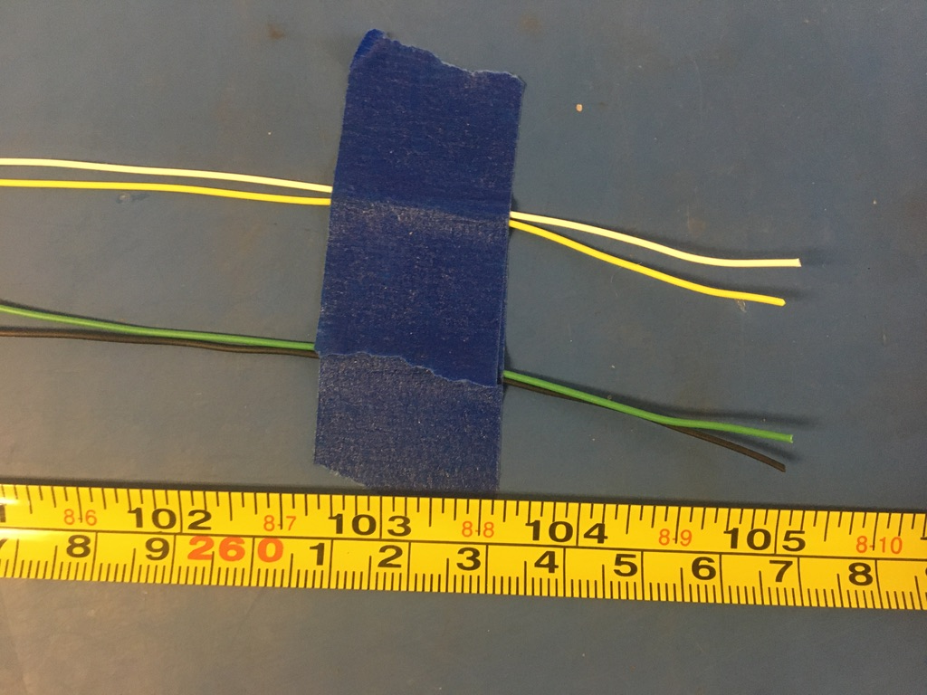
Measure out and cut 118 inches of white, yellow, black, and green 28 awg wire.

Slide 6
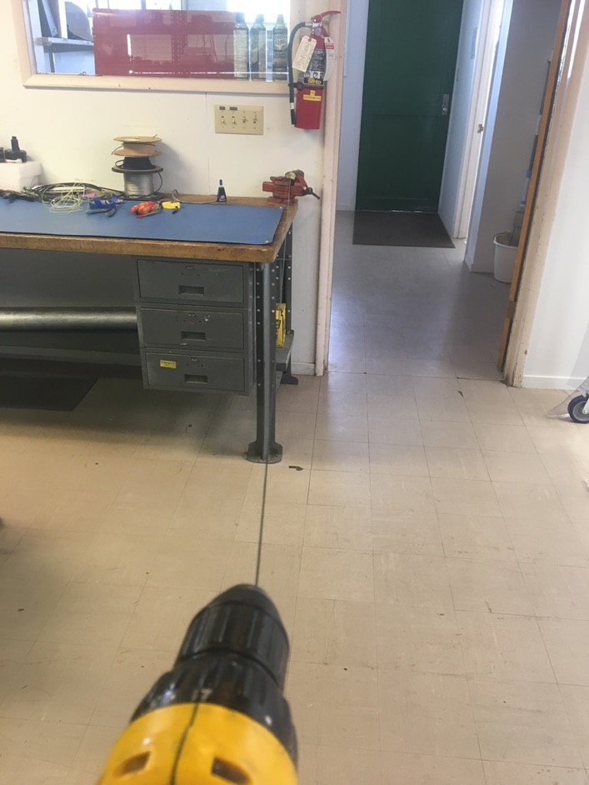
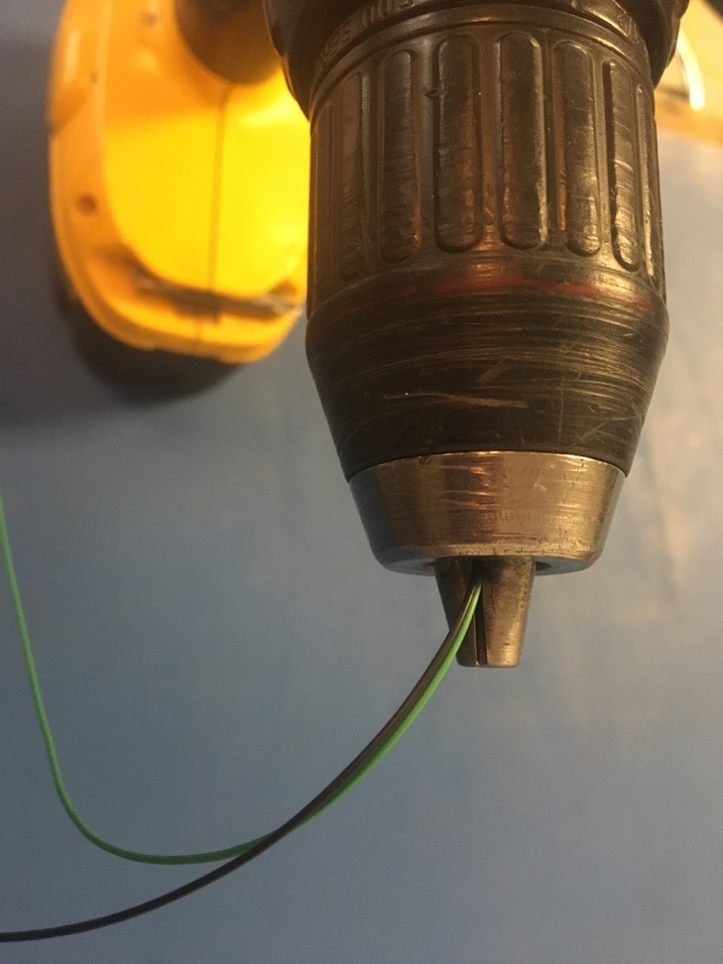
To make the twisted pairs, line the vise with masking tape. Put one end of the black and green wires into the drill. Run the drill till the wires are sufficiently twisted (for reference see the next slide). Repeat with the white and yellow wires.

Slide 7
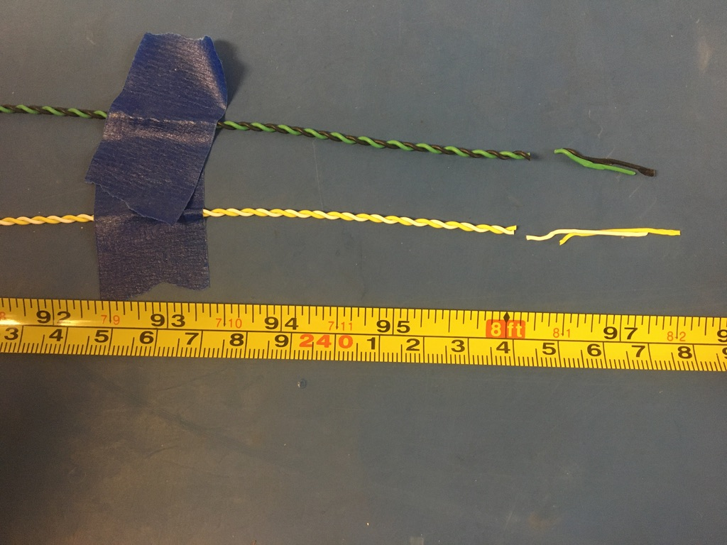
Trim the ends of each twisted pair where they were in the vise and drill. Once trimmed, they should measure about 96 inches.

Slide 8
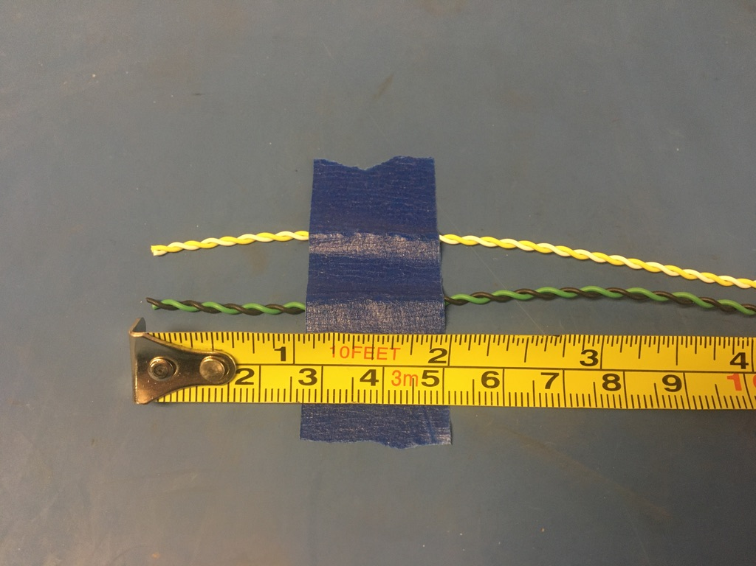
Tape the twisted pairs 2in from their ends.

Slide 9
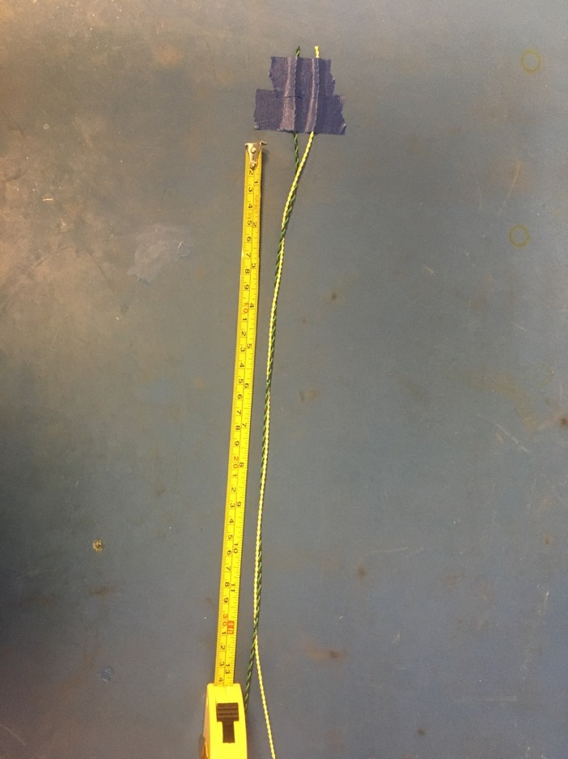
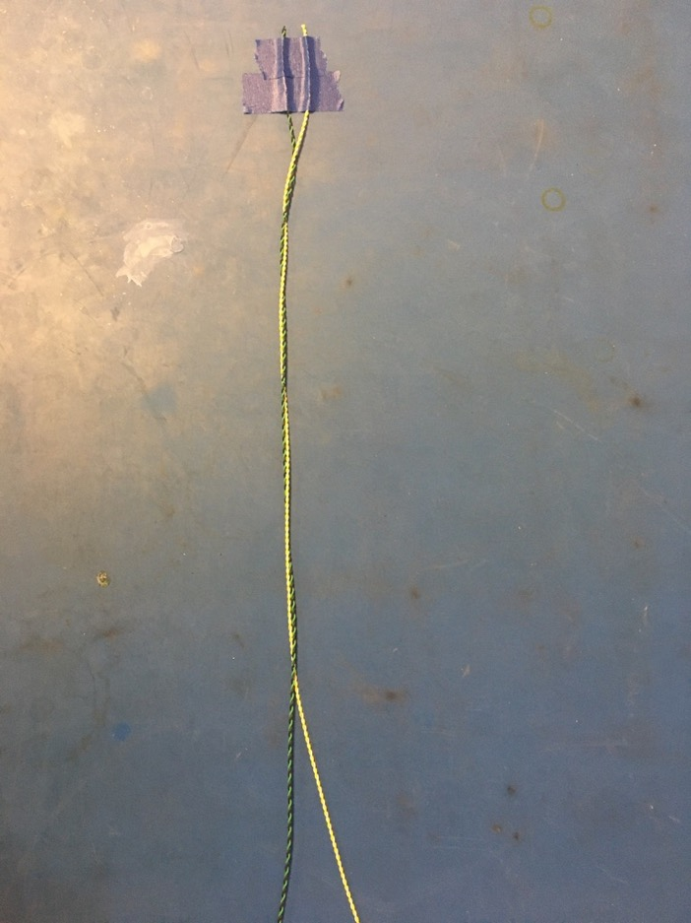
Loosely twist together the two twisted pairs. Only make this twist about a foot long for now. Be sure to twist in the same direction as the twisted pairs (otherwise the twisted pairs will untwist).

Slide 10
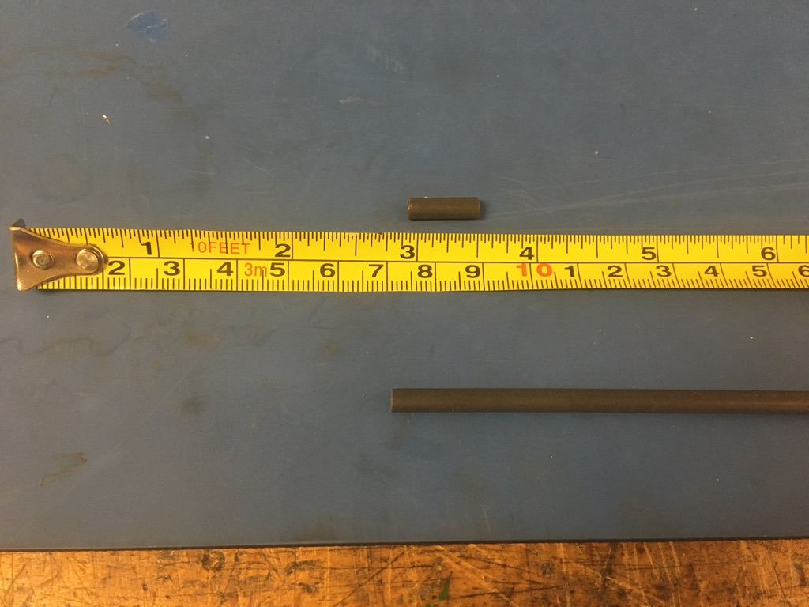
Measure out and cut six lengths of 4.8mm adhesive shrink tube each .5in long.

Slide 11
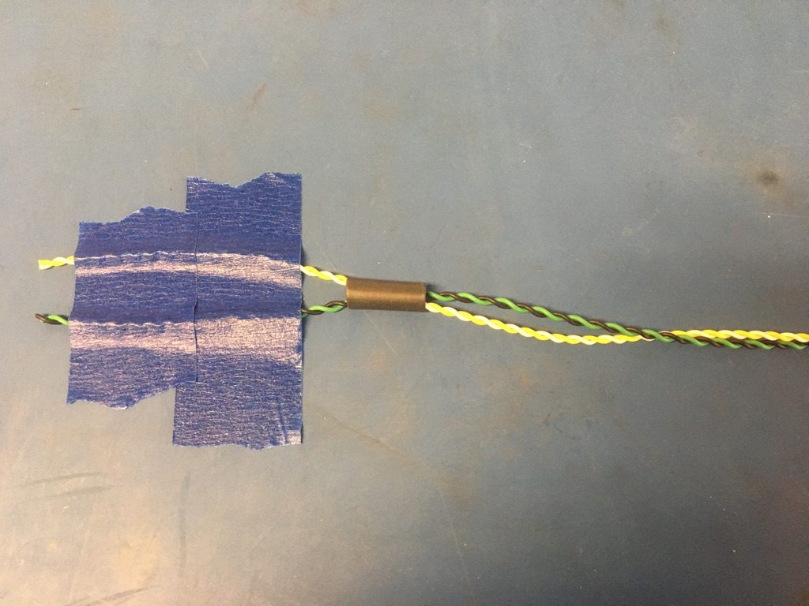
From the un-taped end of the twisted wires, thread a piece of the 4.8mm shrink tube on. Slide the piece of shrink tube all the way up to the tape at the other end.

Slide 12
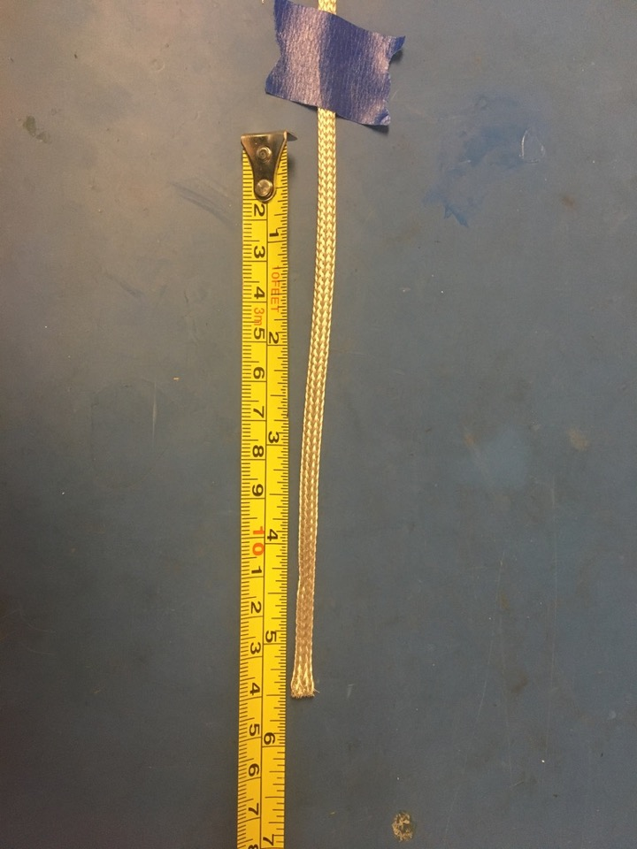
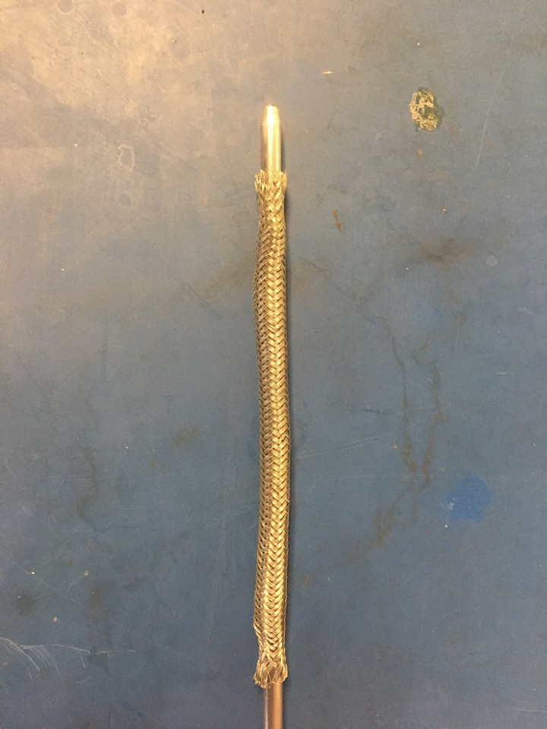
Measure out 5.5 inches of the 1/8th metal braid. Expand it using the metal rod.

Slide 13
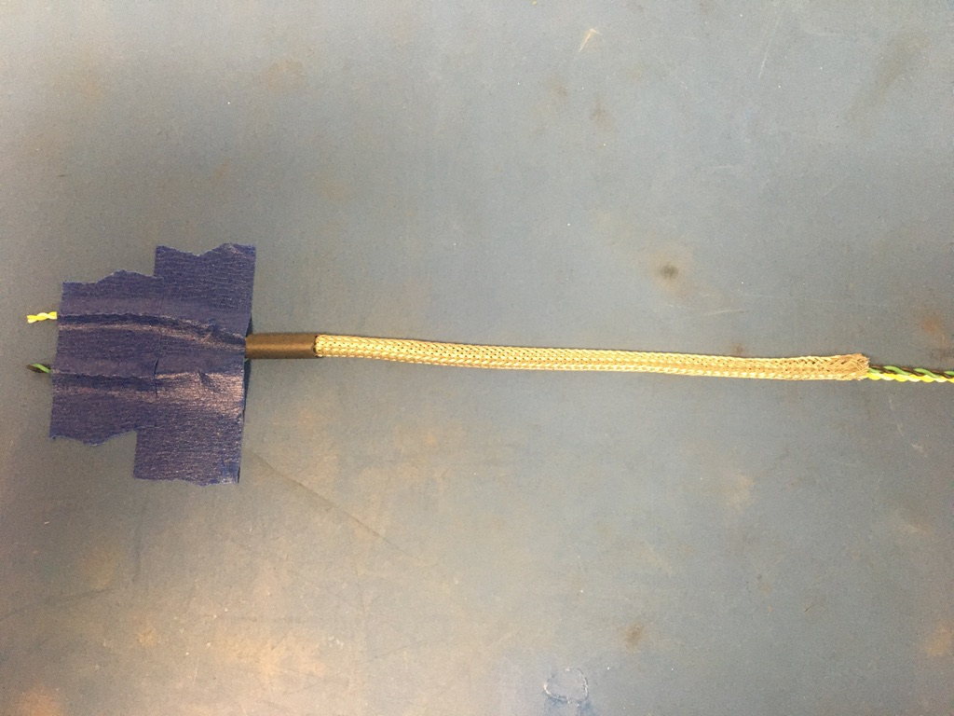
Thread the metal braid onto the un-taped end of twisted wires. Put the metal braid into the piece of shrink tube. The metal braid should end midway through the piece of shrink tube.

Slide 14
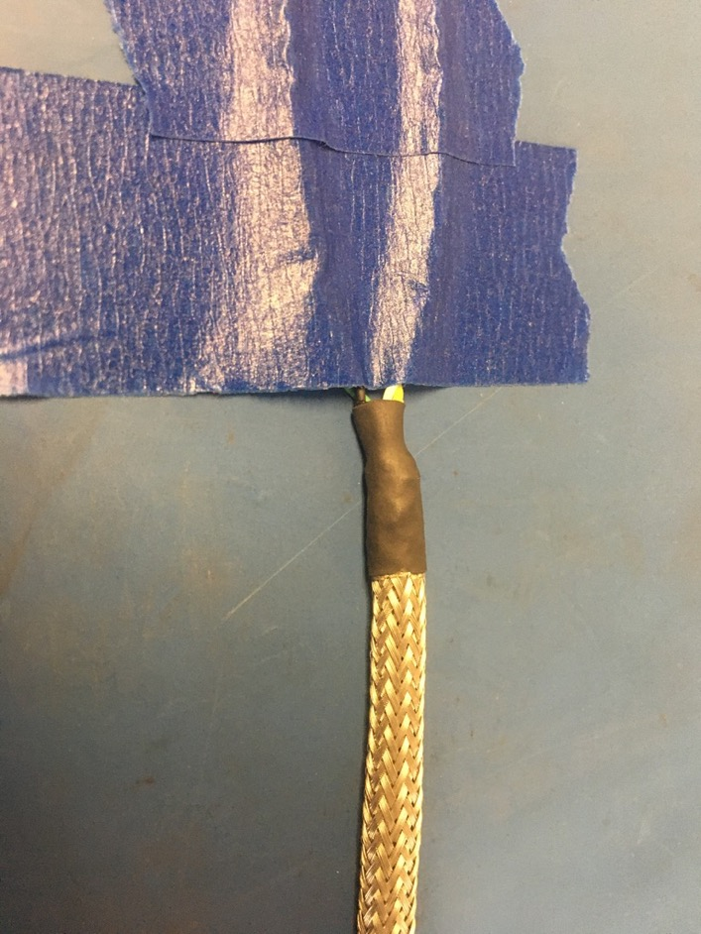
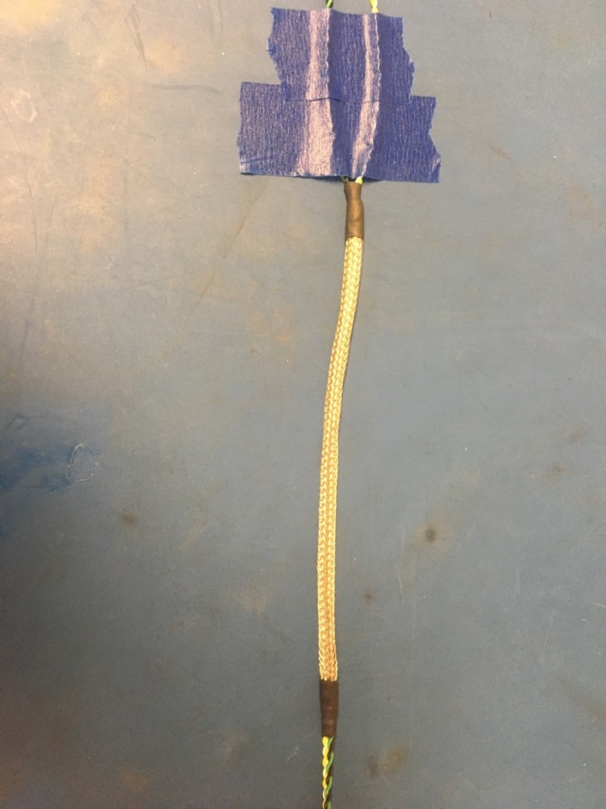
Apply the heat gun to shrink tube. Put another piece of the 4.8mm shrink tube onto the other end of the metal braid. Again, the metal braid should end midway through the piece of shrink tube. Apply the heat gun.

Slide 15
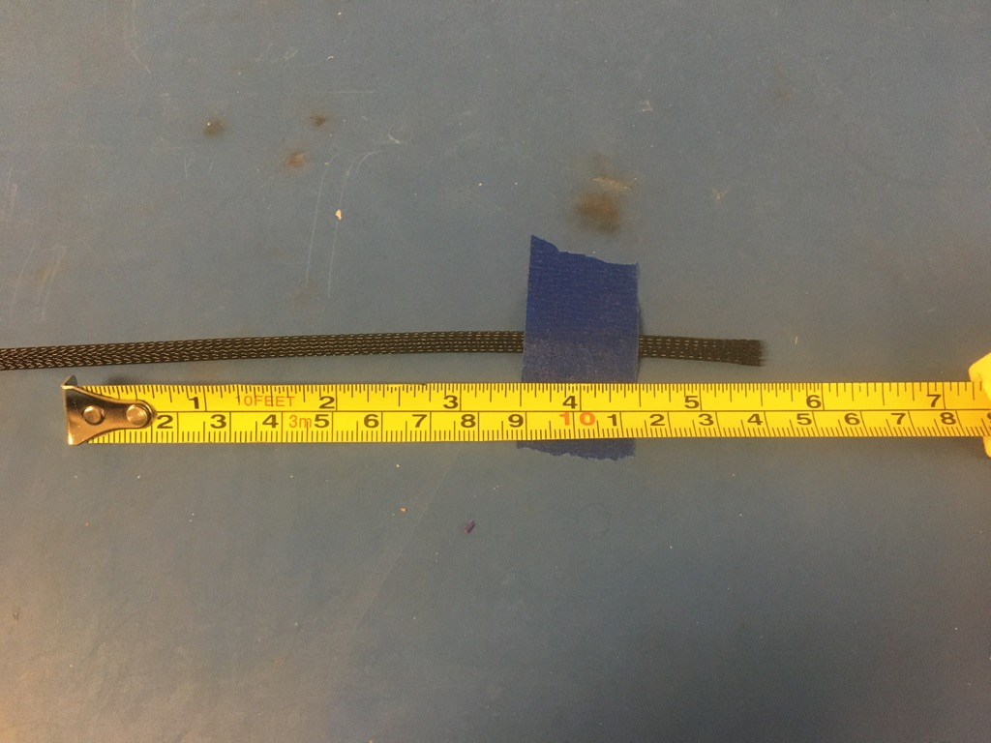
Measure out and cut 5.5 inches of 1/4th plastic braid.

Slide 16
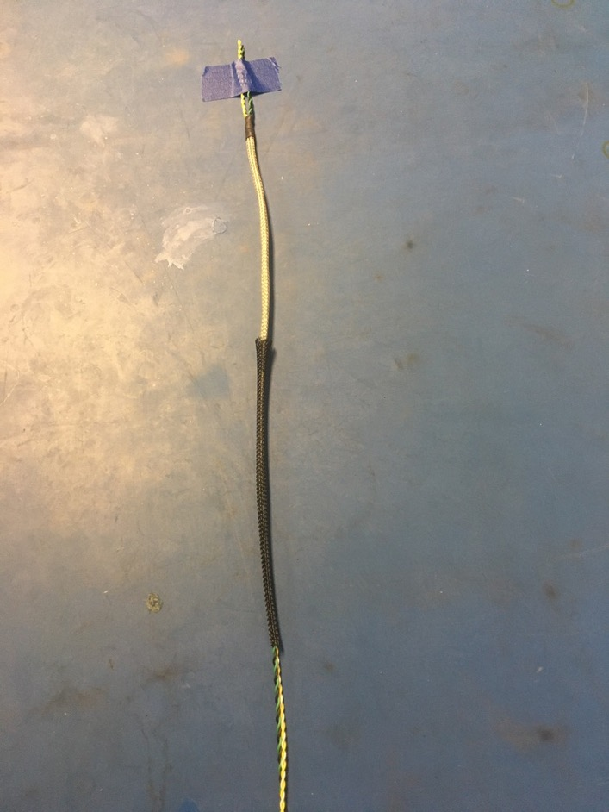
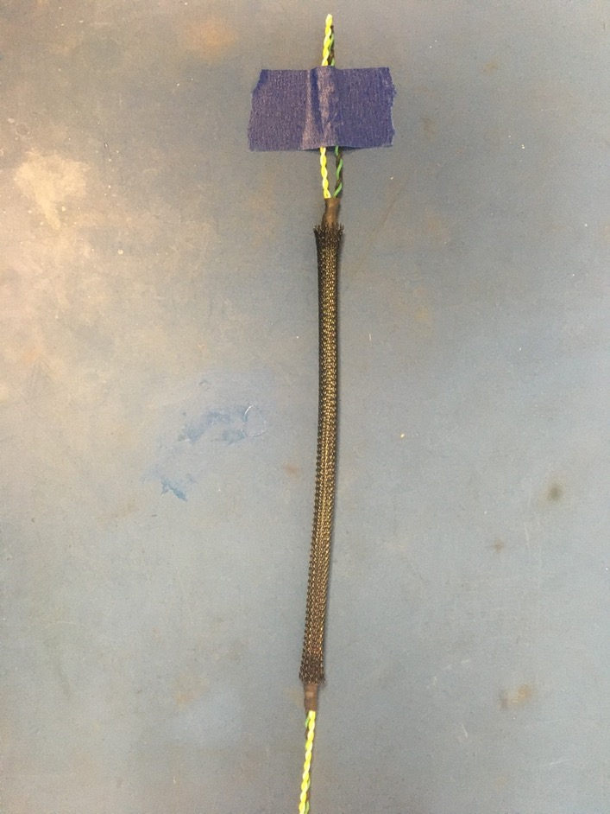
Put the plastic braid onto the twisted wire from the un-taped end. Place it over top the metal braid so that each end of the plastic braid ends midway through the metal shrink tube joints.

Slide 17
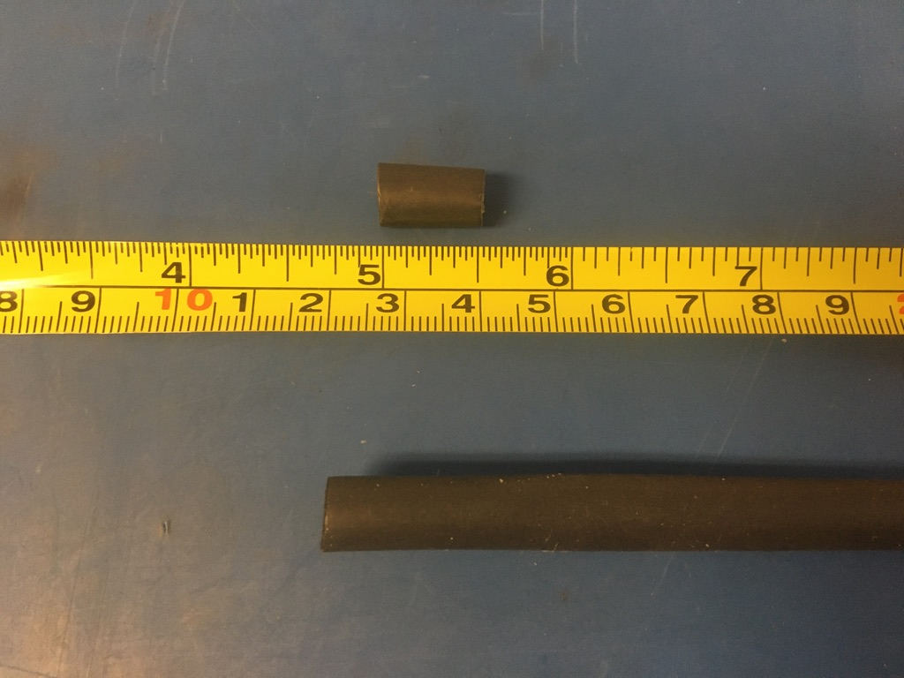
Measure out and cut nine lengths of 6.4mm adhesive shrink tube each .5in long.

Slide 18
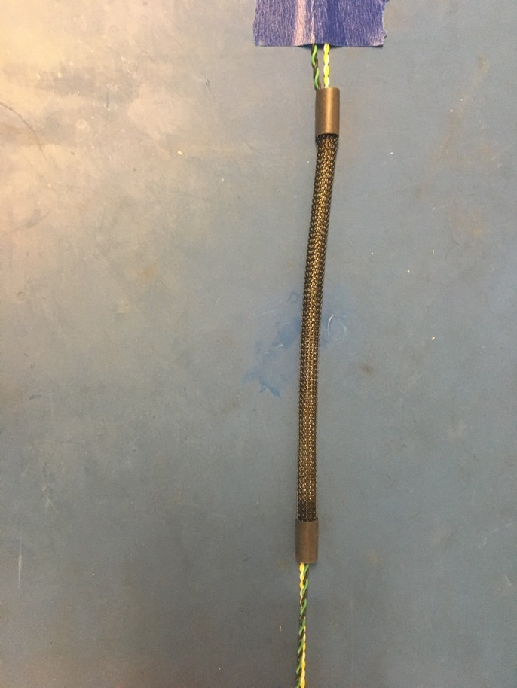
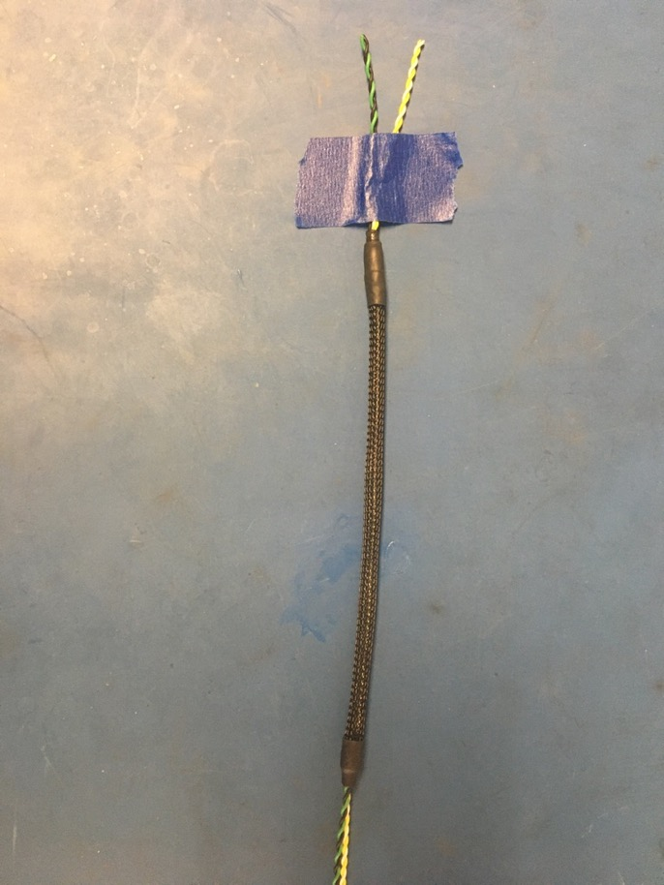
Put two pieces of the 6.4mm shrink tube onto the twisted wires. Place the shrink tube on the plastic braid ends so that the plastic braid ends midway through the pieces of shrink tube. Apply the heat gun.

Slide 19
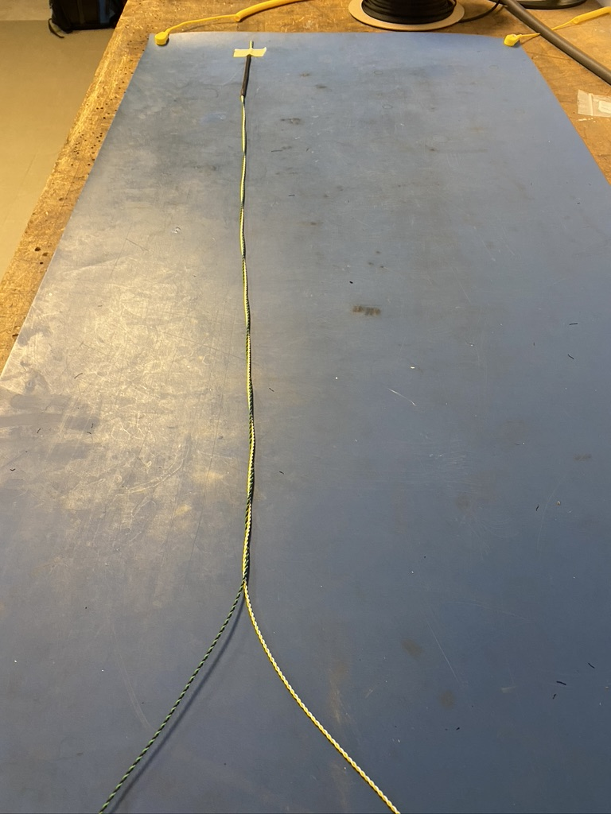
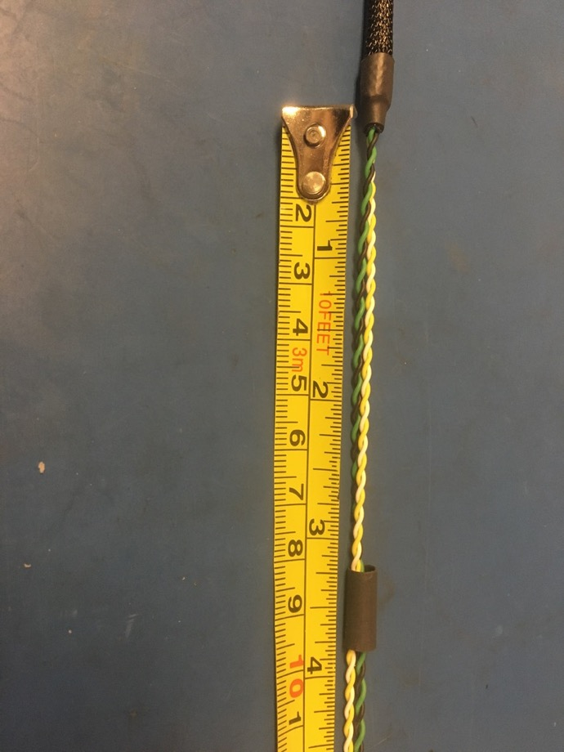
Continue the loose twist of the twisted pairs about two feet further down the harness. From the un-taped end of the harness, thread another piece of the 4.8mm shrink tube on. Slide the piece of shrink tube toward the other end of the harness until its 3.25 inches away from the end of the plastic braid shrink tube that was just applied.

Slide 20
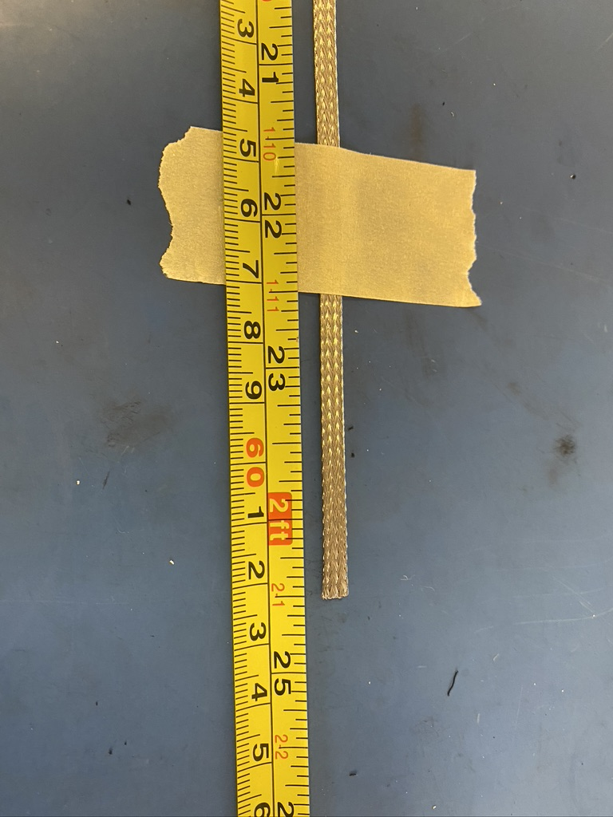
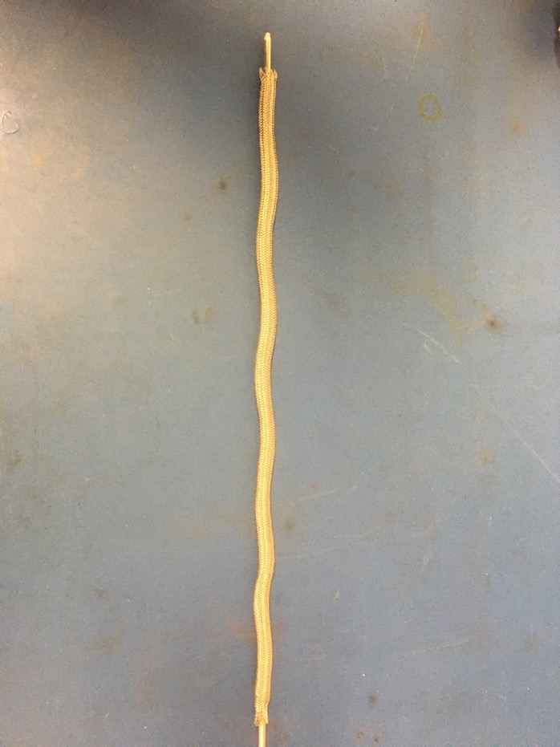
Measure out 24.5 inches of the 1/8th metal braid. Expand it using the metal rod.

Slide 21
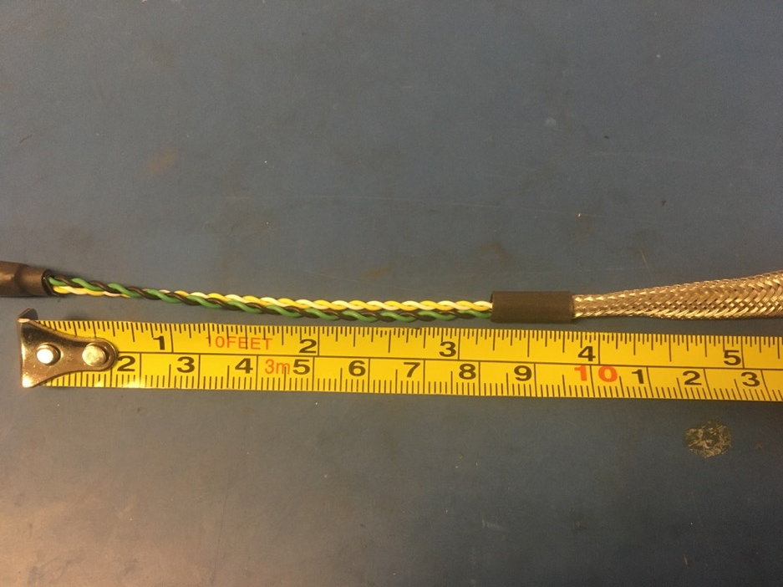
Thread the metal braid onto the un-taped end of the harness. Put the metal braid into the piece of shrink tube. The metal braid should end midway through the piece of shrink tube. Apply the heat gun.
Shrunken shrink tube

Slide 22
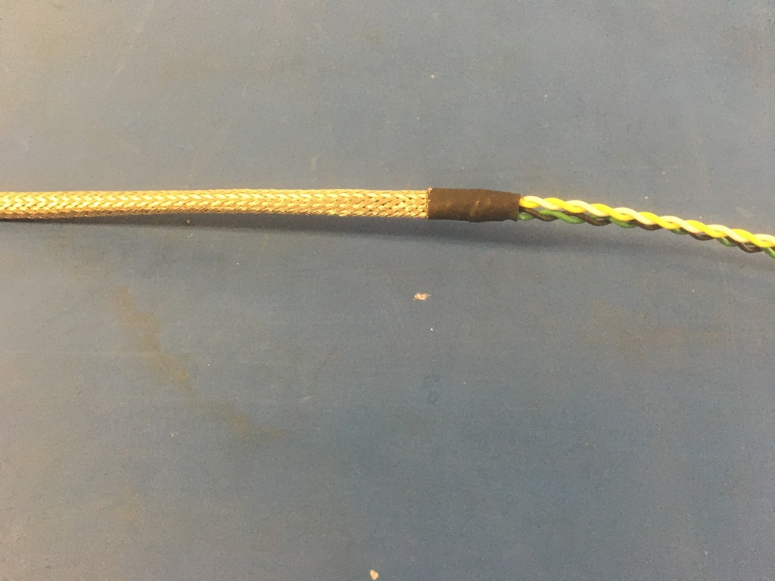
Put another piece of the 4.8mm shrink tube onto the other end of the metal braid. Again, the metal braid should end midway through the piece of shrink tube. Apply the heat gun.

Slide 23
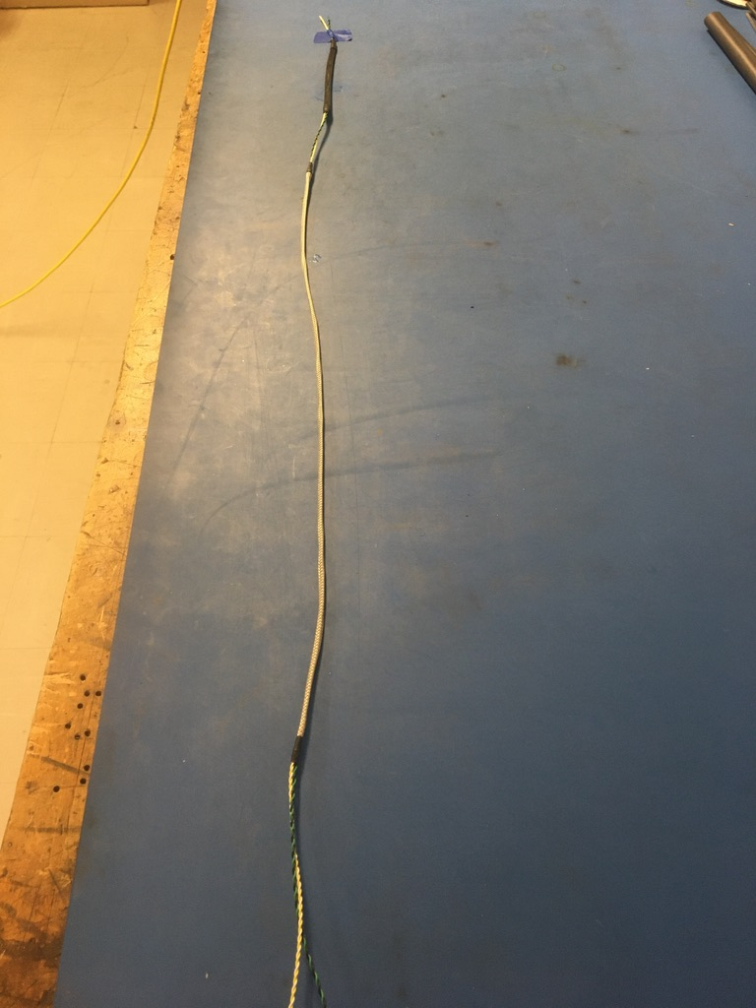
Thus far, the harness should appear as shown on the left.

Slide 24
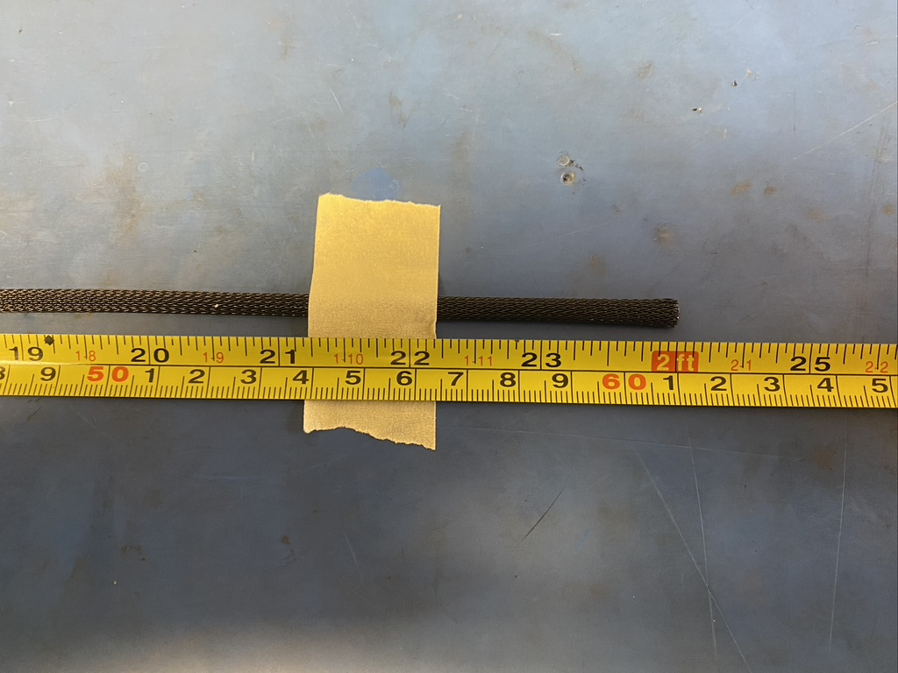
Measure out and cut 24 inches of 1/4th plastic braid.

Slide 25
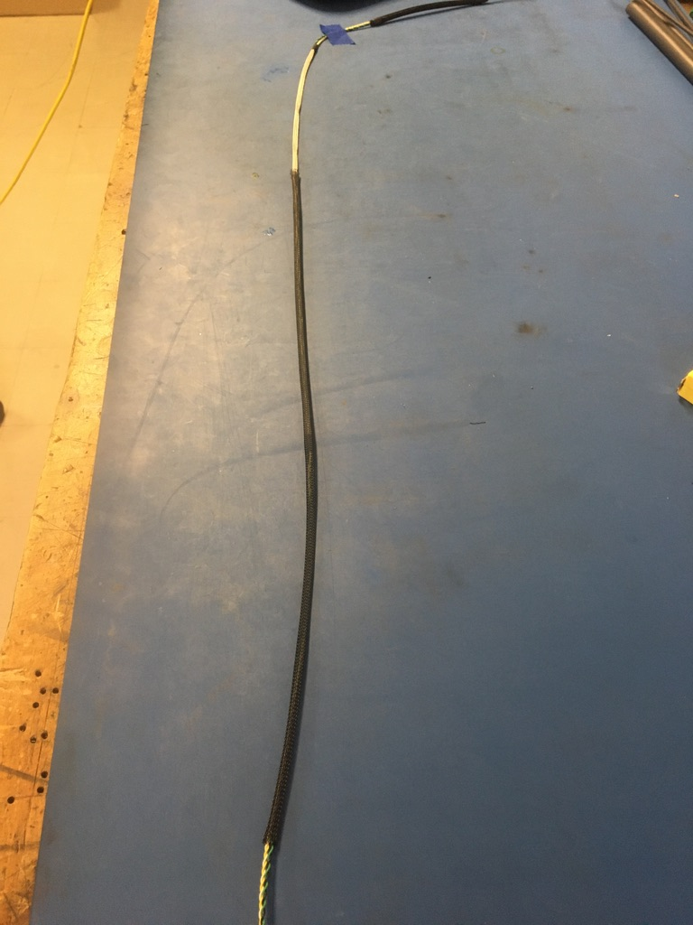
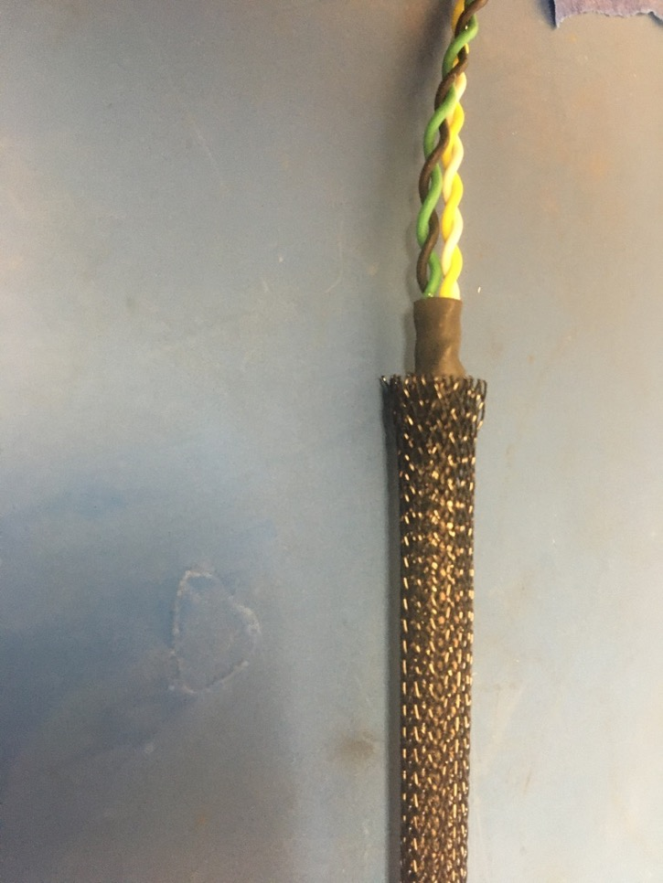
Put the plastic braid onto the harness from the un-taped end. Place it over top the metal braid so that each end of the plastic braid ends midway through the metal shrink tube joints.

Slide 26
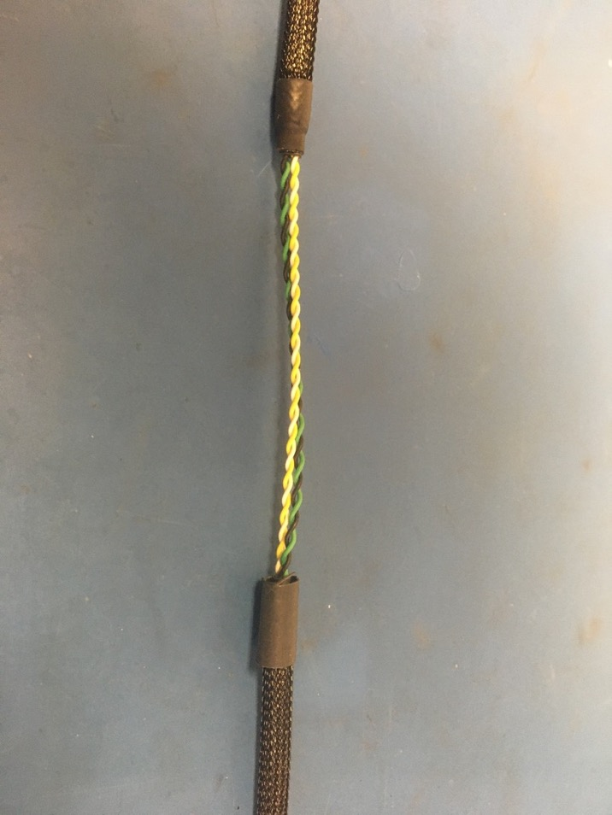
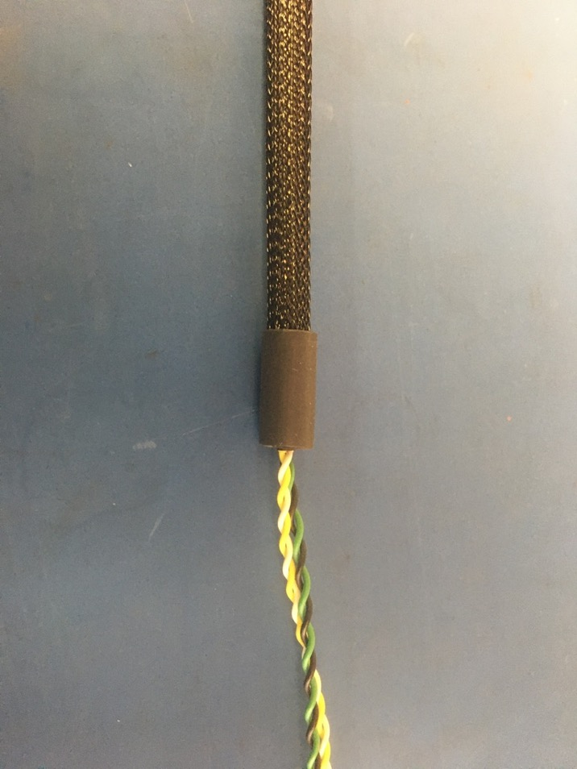
Put two pieces of the 6.4mm shrink tube onto the harness. Place the shrink tube on plastic braid ends so that the plastic braid ends midway through the pieces of shrink tube.

Slide 27
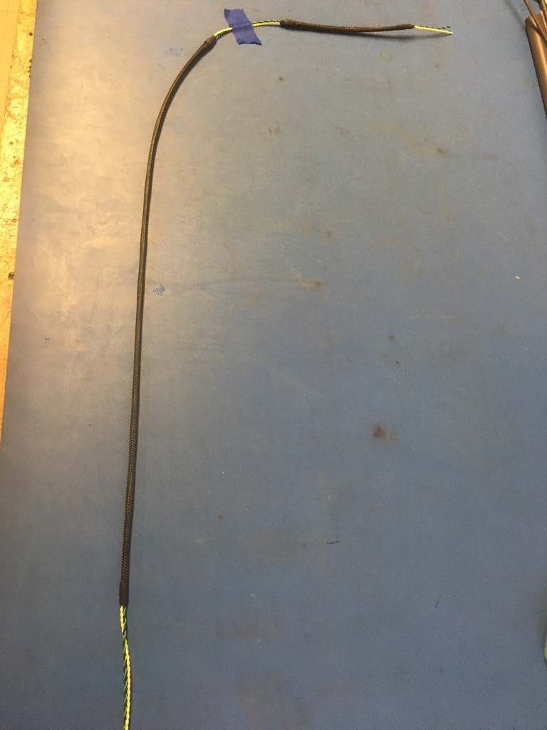
Apply the heat gun.

Slide 28
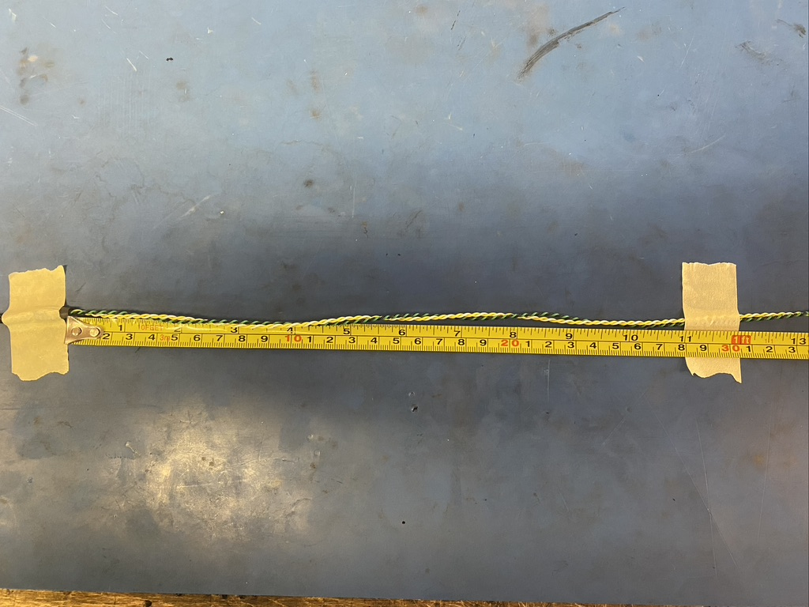
Continue the loose twist of the twisted wires for an additional 30 inches. Place a piece of tape at the 12 inch mark of the continued twist.

Slide 29
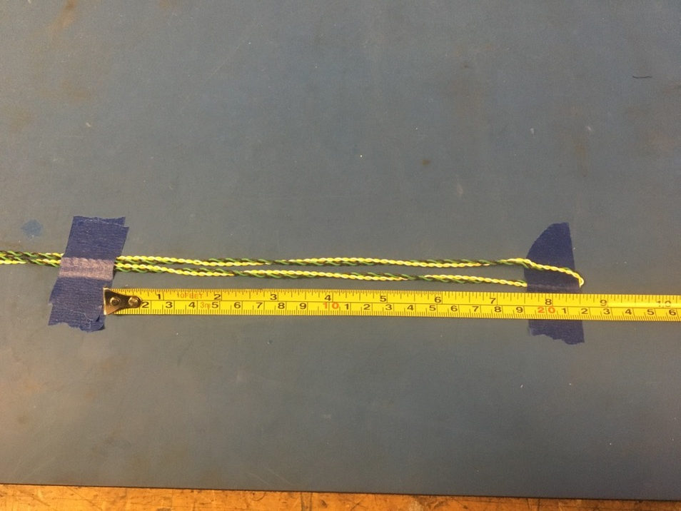
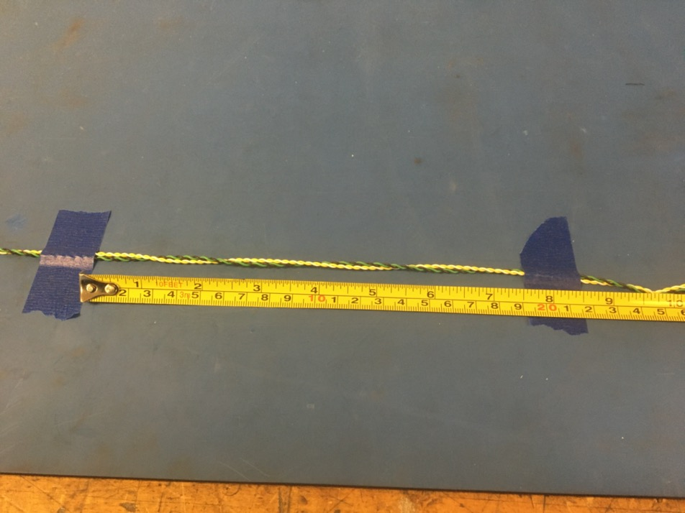
Place a second piece of tape 8.5 inches from the first piece. Then double back the continued twist as shown on the right. Tape down the end of the continued twist with a third piece of tape placed on top of the first.

Slide 30
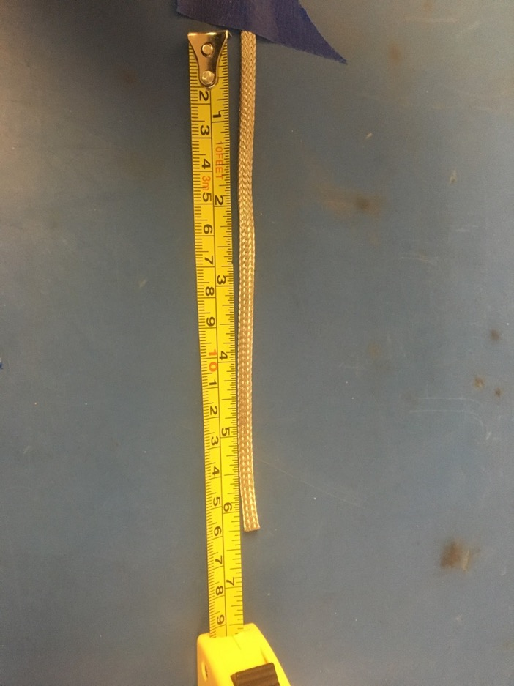

Measure out 6.25 inches of the 1/8th metal braid. Expand it using the metal rod.

Slide 31
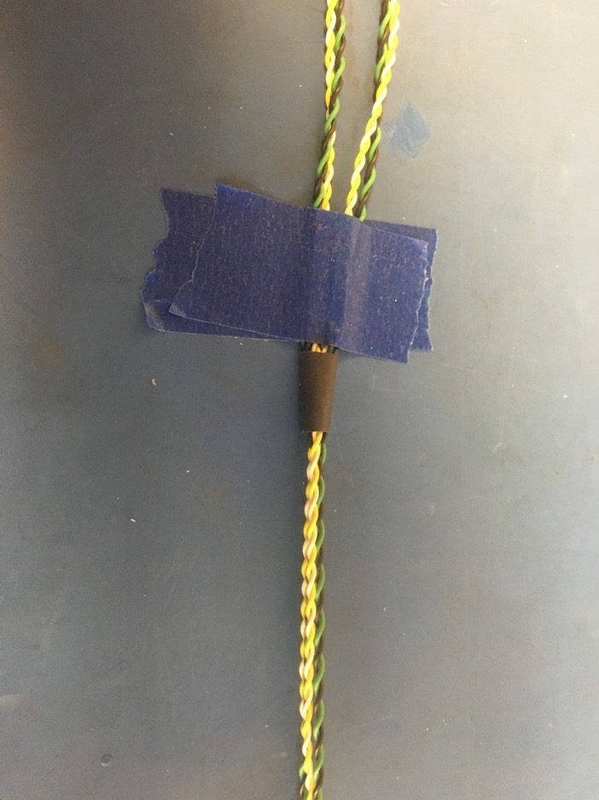
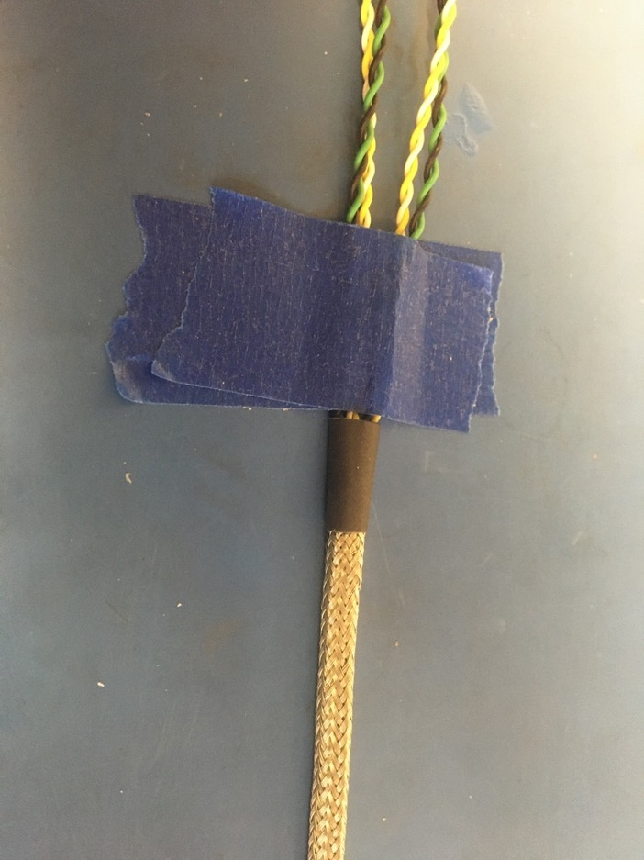
From wire loop, thread a piece of the 6.4mm shrink tube on. Slide the piece of shrink tube all the way down to the layered tape. Thread the metal braid onto the wire loop. Put the metal braid into the piece of shrink tube. The metal braid should end midway through the piece of shrink tube.

Slide 32
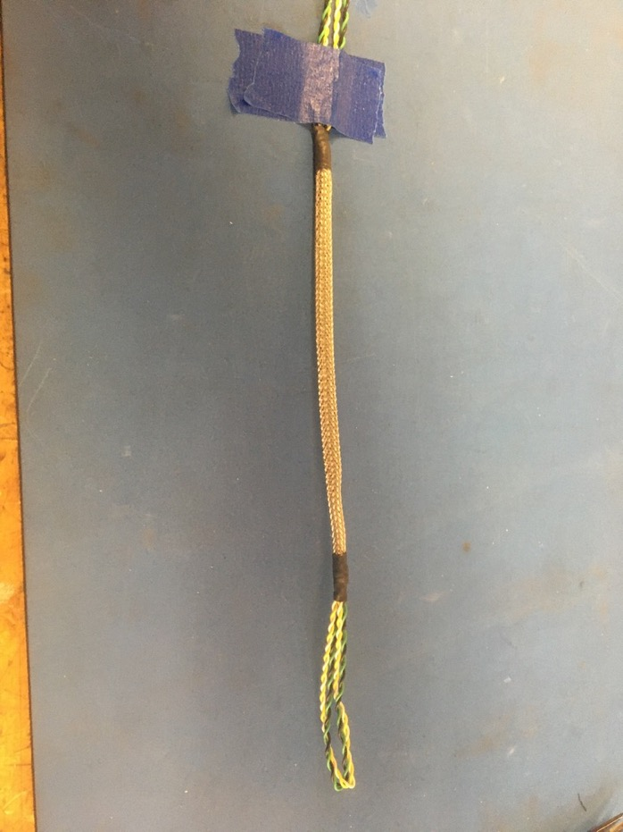
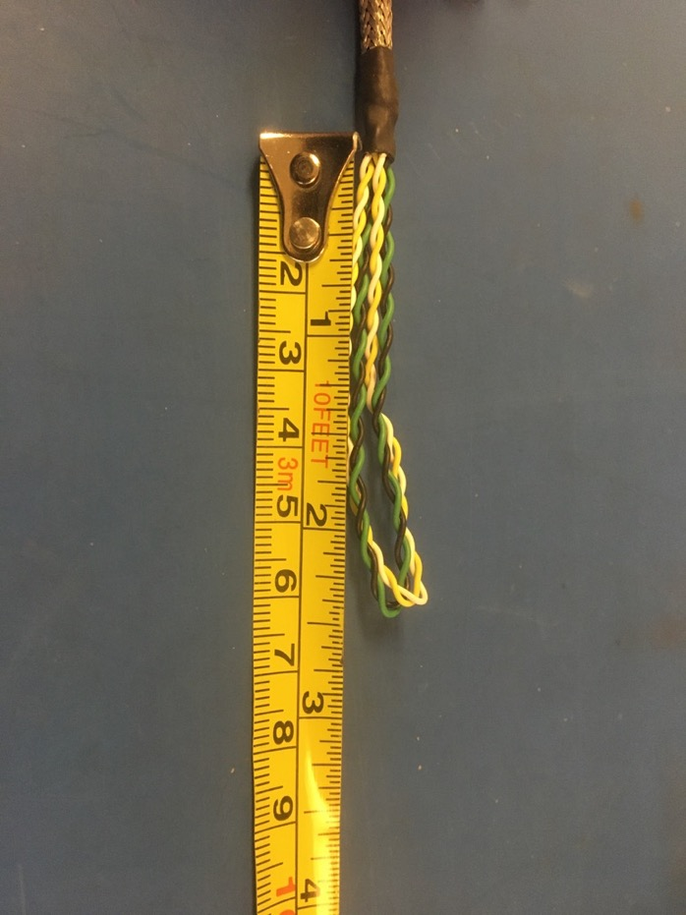
Apply the heat gun. Put another piece of the 6.4mm shrink tube onto the other end of the metal braid. Again, the metal braid should end midway through the piece of shrink tube. Apply the heat gun.

Slide 33
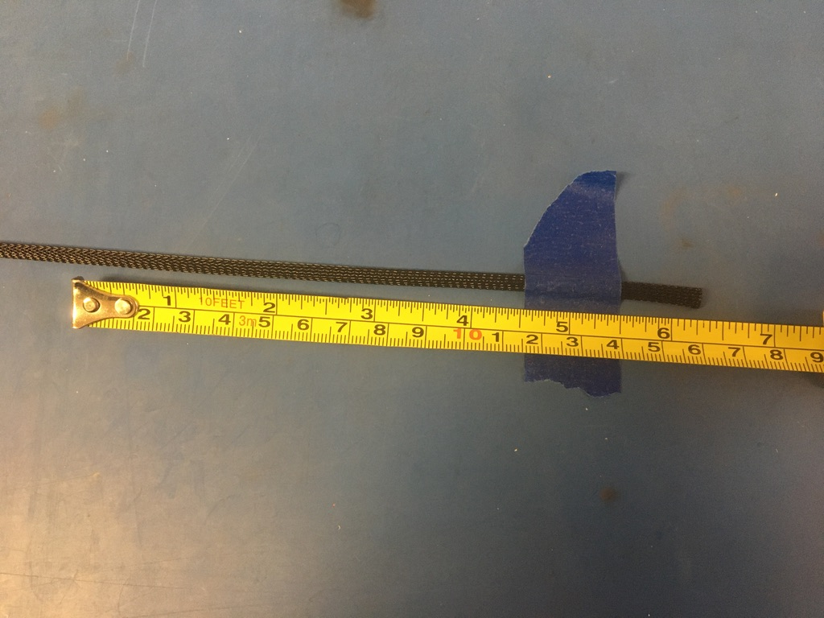
Measure out and cut 6.25 inches of 1/4th plastic braid.

Slide 34
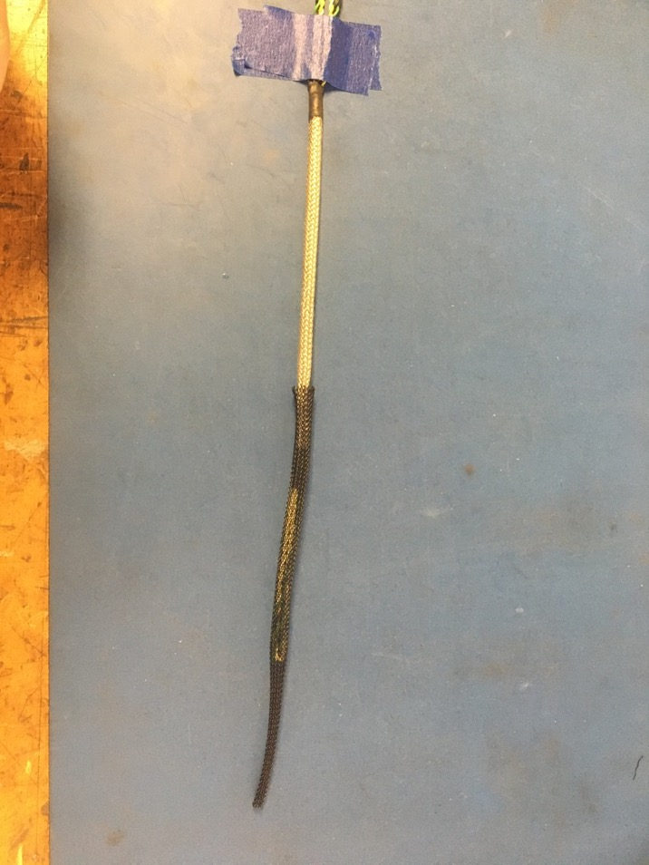
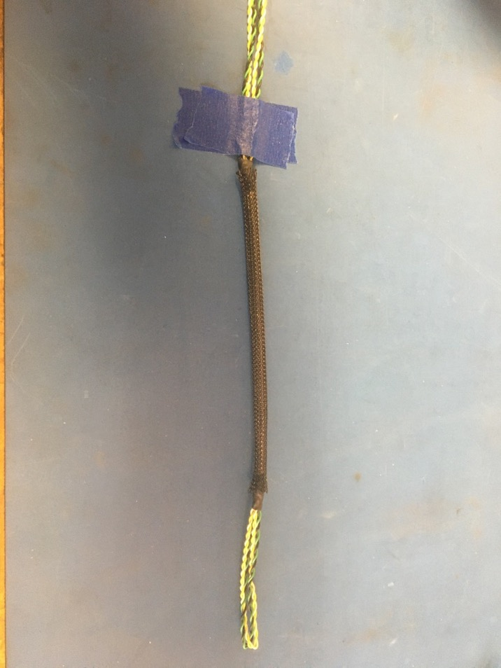
Put the plastic braid onto the wire harness via the wire loop. Place it over top the metal braid so that each end of the plastic braid ends midway through the metal shrink tube joints.

Slide 35
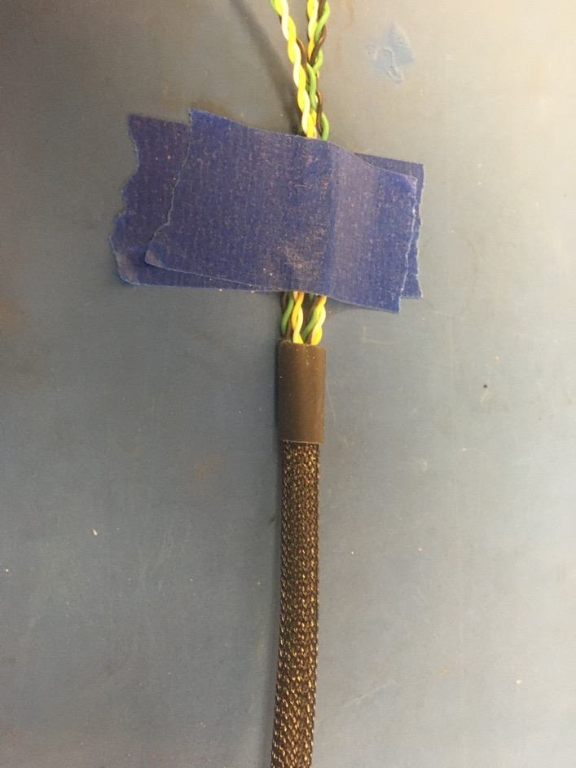
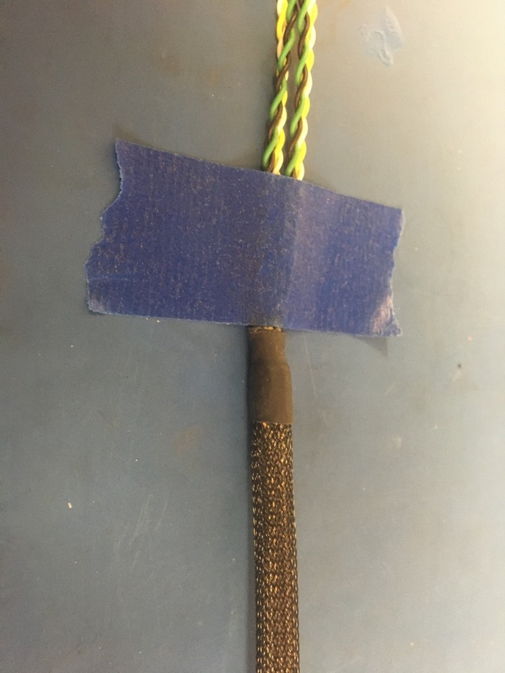
Put a piece of the 6.4mm shrink tube via the wire loop. Place the shrink tube on the plastic braid end furthest from the wire loop. The plastic braid should also end midway through the pieces of shrink tube. Apply the heat gun.

Slide 36

Put another piece of the 6.4mm shrink tube onto the other end of the plastic braid. Again, the plastic braid should end midway through the piece of shrink tube. Apply the heat gun.

Slide 37


Continue the loose twist of the twisted pairs for the wrest of their length. Thread a piece of the 4.8mm shrink tube onto the wire harness. Slide the piece of shrink tube toward the other end of the harness until its 3 inches away from the end of the plastic braid shrink tube that was applied on slide 35.

Slide 38


Measure out 30.5 inches of the 1/8th metal braid. Expand it using the metal rod.

Slide 39


Thread the metal braid onto the wire harness. Put the metal braid into the piece of shrink tube. The metal braid should end midway through the piece of shrink tube. Apply the heat gun.

Slide 40


Put another piece of the 4.8mm shrink tube onto the other end of the metal braid. Again, the metal braid should end midway through the piece of shrink tube. Apply the heat gun.

Slide 41


Measure out and cut 12 inches of black 24 awg wires. Strip 3-4mm off one end.

Slide 42


Solder the stripped end of the black wire onto the metal braid near the shrink tube joint at end of the harness. The black wire should be soldered so the that its length runs with that of the metal braid.

Slide 43

Measure out and cut 30 inches of 1/4th plastic braid.

Slide 44


Put the plastic braid onto the wire harness. Place it over top the metal braid so that each end of the plastic braid ends midway through the metal shrink tube joints.

Slide 45


Put the last piece of the 6.4mm shrink tube onto the wire harness. Place the shrink tube on plastic braid end without the ground wire. The plastic braid should end midway through the piece of shrink tube. Apply the heat gun.

Slide 46

Thread the ground wire through one of the holes in the plastic braid so it appears as shown.

Slide 47


Measure out and cut one length of 6.4mm adhesive shrink tube that is 1in long. Place the piece of shrink tube onto the ground wire end of the harness. The shrink tube should be placed such that it covers the solder joint and the length of shrink tube beneath. Apply the heat gun.

Slide 48

Measure and cut the ground wire end of the twisted pairs so that they measure 2.5 inches.

Slide 49


Strip all the wires (about 2-3mm). Using the KK 254 crimper, crimp on KK 254 tips. Be sure to use slot A.

Slide 50

Once the wire ends are crimped, they should look as shown: isolation held by the first grip but not the second and a bit of exposed wire peaking out the end of the second grip.
Exposed wire just visible
Isolation in first grip

Slide 51


Before inserting the tips into the connector, have the extrusions of both face down. Then push each tip into the hole of the connector until the it clicks. If there are difficulties with pushing the wire tip in by hand, use the metal extraction tool to push on the bottom edge of it until it clicks in place. Please reference the accompanying pin out document to see where each wire should go.

Slide 52

Once all the wires are inserted, the connector should appear as shown on the left.

Slide 53


Take one of the feed through connectors and put it in the vise as shown. The side of the connector shown on the left is considered the front of the connector.

Slide 54


Using the T insertion tool, insert the white wire into the feed through connector. The middle two teeth of the insertion tool should be alternated in pushing on the middle of the wire (shown below) till its completely inserted. Push on the insertion tool gently to slowly insert the wire as it’s easily damaged if inserted too fast.

Slide 55


Once inserted completely, the white wire should appear as shown on the left. Proceed to insert all the wires into the connector. Once done, the connector should appear as shown on the right. The wire positions are the same for each of the subsequent feed through connectors.

Slide 56

Trim the ends of the wires hanging out of the connector.

Slide 57

The other four of the feed through connectors should be placed at the numbered locations shown below. The numbers corroborate with the sensor number they plug into on the feed.
2
3
5
1
6

Slide 58


At the next connector position (sensor 5), the connector should be placed about midway (1.5in) through the length of wire. Put the wires into the connector as previously demonstrated. When all the wires are interested, the connector should appear as shown on the right. Be sure that the connector is facing the same direction as the first connector

Slide 59

At the next two connector positions (from left to right, sensor 3 and 2), the connectors should be placed at 3.25in and 8in along the length of wire. Put the wires into the connector as previously demonstrated. Make sure that the connectors as facing the same direction as the other connectors (the numbers should face away from the wire loop).

Slide 60

At the final connector position (sensor 1), the connector should be placed at the crux of the wire loop. Put the wires into the connector as previously demonstrated. The direction the connector faces does not matter in this case.

Slide 61

Wire harness complete! The ground wire tip will be added later.

